Slide 1

Geometry
Unit 13, Lesson 12 Congruence and Similarity Volume 2, pg. 348

Slide 2


Benchmark
MA.912.GR.3.3
Use coordinate geometry to solve mathematical and real-world geometric problems involving lines, circles, triangles, and quadrilaterals.
volume 2, pg. 348

Slide 3
Integrated Mathematical Thinking and Reasoning Standards
MA.K12.MTR.1.1 Actively participate in effortful learning both individually and collectively.
MA.K12.MTR.4.1 Engage in discussions that reflect on the mathematical thinking of self and others.
MA.K12.MTR.5.1 Use patterns and structure to help understand and connect mathematical concepts.
volume 2, pg. 348

Slide 4

Learning Target
I can use coordinate geometry to justify congruence and similarity in triangles and quadrilaterals.
volume 2, pg. 348

Slide 5

Warm-Up
volume 2, pg. 348

Slide 6
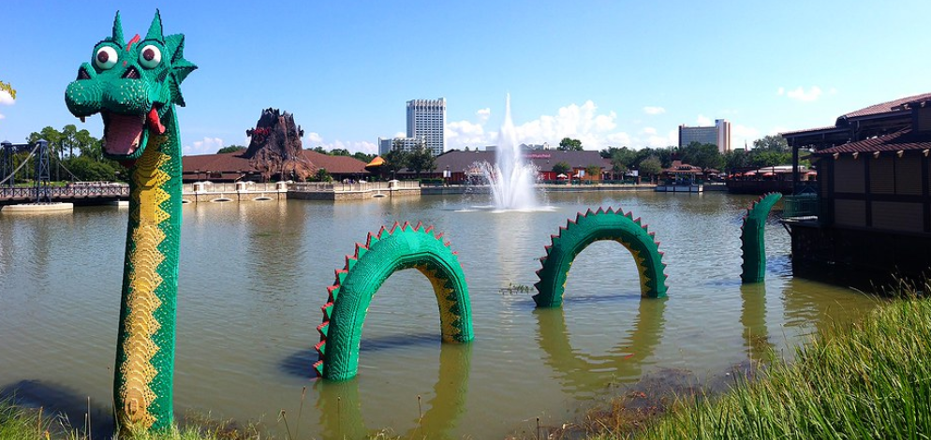
13.12.1 Warm-Up: Notice and Wonder
Brickley, the LEGO sea serpent in Lake Buena Vista at Disney Springs near Orlando, Florida, was made in 1997 from $170,000$ LEGO bricks and is $30$ feet long.
volume 2, pg. 348

Slide 7
What do you notice?
What do you wonder?
volume 2, pg. 348

Slide 8

Exploration
volume 2, pg. 349

Slide 9

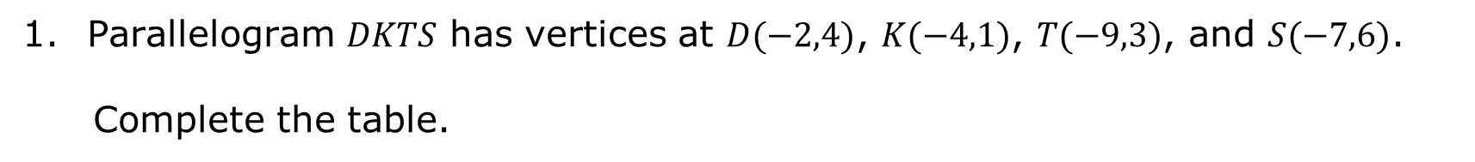
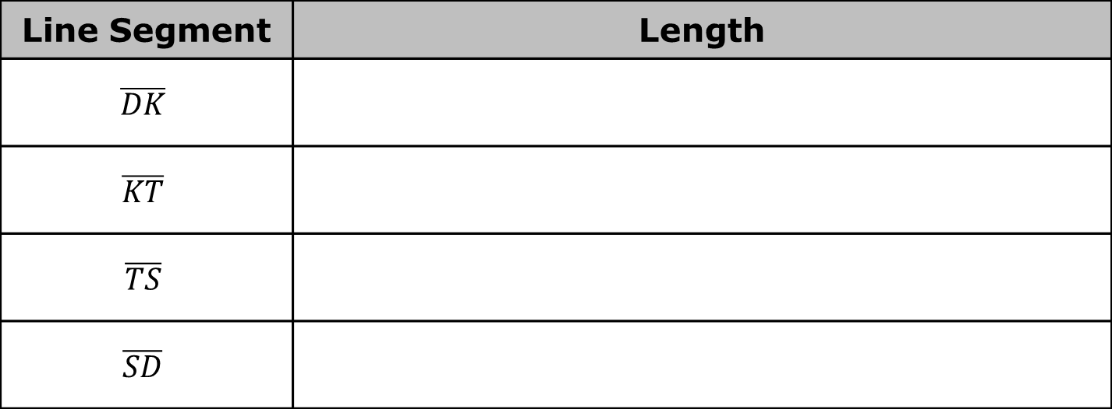
13.12.2 Exploration: Congruence and Similarity
Parallelogram 𝐷𝐾𝑇𝑆 has vertices at $D(−2,4)$, $K(−4,1)$, $T(−9,3)$, and $S(−7,6)$.
Complete the table.
Line Segment | Length
$$\overline{DK}$$
$$\overline{KT}$$
$$\overline{TS}$$
$$\overline{SD}$$
volume 2, pg. 349

Slide 10
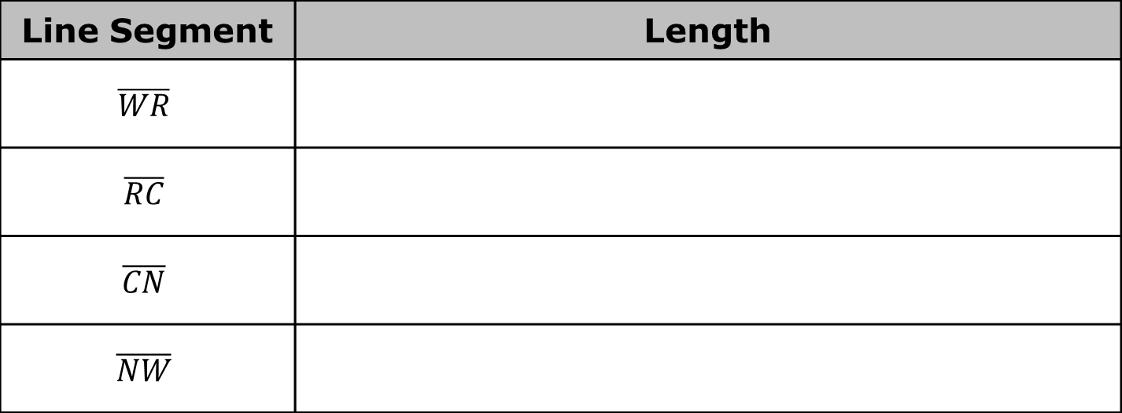
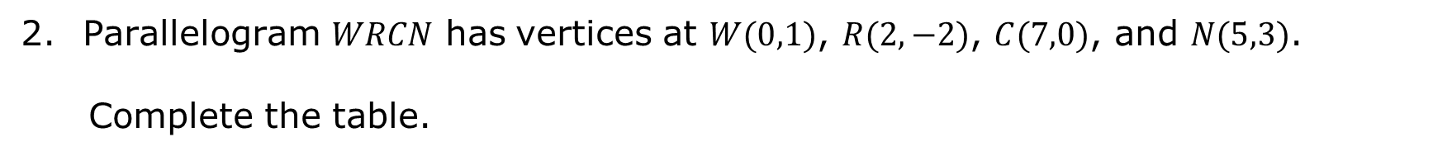
Parallelogram 𝑊𝑅𝐶𝑁 has vertices at $W(0,1)$, $R(2,−2)$, $C(7,0)$, and $N(5,3)$.
Complete the table.
Line Segment | Length
$$\overline{WR}$$
$$\overline{RC}$$
$$\overline{CN}$$
$$\overline{NW}$$
volume 2, pg. 349

Slide 11
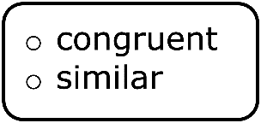
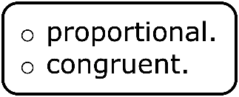
What do you notice about the lengths of the line segments in parallelograms 𝐷𝐾𝑇𝑆 and 𝑊𝑅𝐶𝑁?
Complete the statement.
Parallelogram 𝐷𝐾𝑇𝑆 may be to
parallelogram 𝑊𝑅𝐶𝑁 because all sides are
volume 2, pg. 349

Slide 12
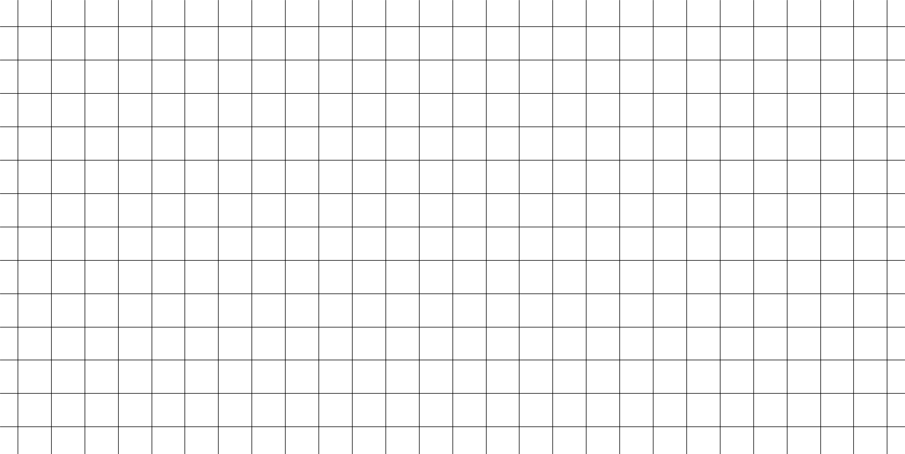
Work with your partner to describe how the parallelograms are congruent or similar using transformations. State which image you used as the preimage.
volume 2, pg. 350

Slide 13
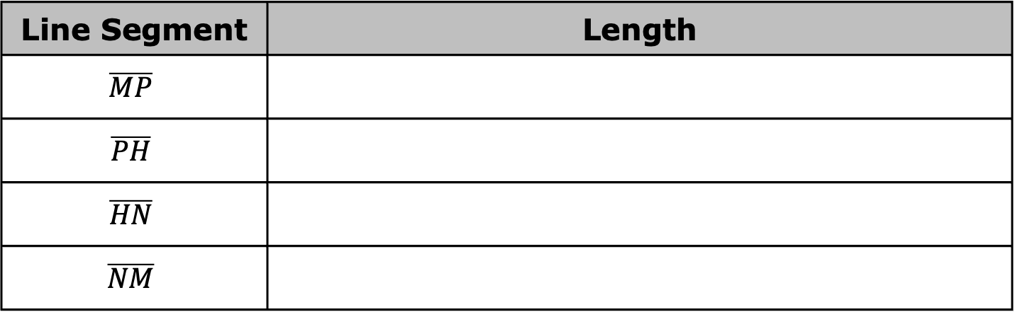
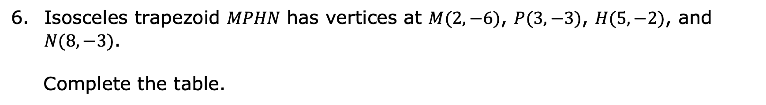
Isosceles trapezoid 𝑀𝑃𝐻𝑁 has vertices at $M(2,−6)$, $P(3,−3)$, $H(5,−2)$, and $N(8,−3)$.
Complete the table.
Line Segment | Length
$$\overline{MP}$$
$$\overline{PH}$$
$$\overline{HN}$$
$$\overline{NM}$$
volume 2, pg. 350

Slide 14

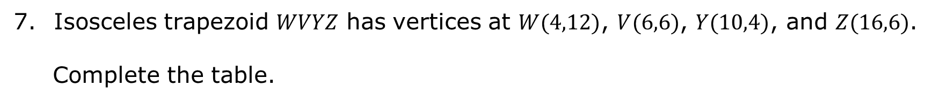
Isosceles trapezoid 𝑊𝑉𝑌𝑍 has vertices at $W(4,12)$, $V(6,6)$, $Y(10,4)$, and $Z(16,6)$.
Complete the table.
Line Segment | Length
$$\overline{WV}$$
$$\overline{VY}$$
$$\overline{YZ}$$
$$\overline{ZW}$$
volume 2, pg. 350

Slide 15
What do you notice about the lengths of the line segments in isosceles trapezoids 𝑀𝑃𝐻𝑁 and 𝑊𝑉𝑌𝑍?
Complete the statement.
Isosceles trapezoid 𝑀𝑃𝐻𝑁 is to
isosceles trapezoid 𝑊𝑉𝑌𝑍 because all sides are
volume 2, pg. 350

Slide 16
Work with your partner to describe how the trapezoids are congruent or similar using transformations. State which image you used as the preimage.
volume 2, pg. 351

Slide 17

Guided Practice
volume 2, pg. 351

Slide 18

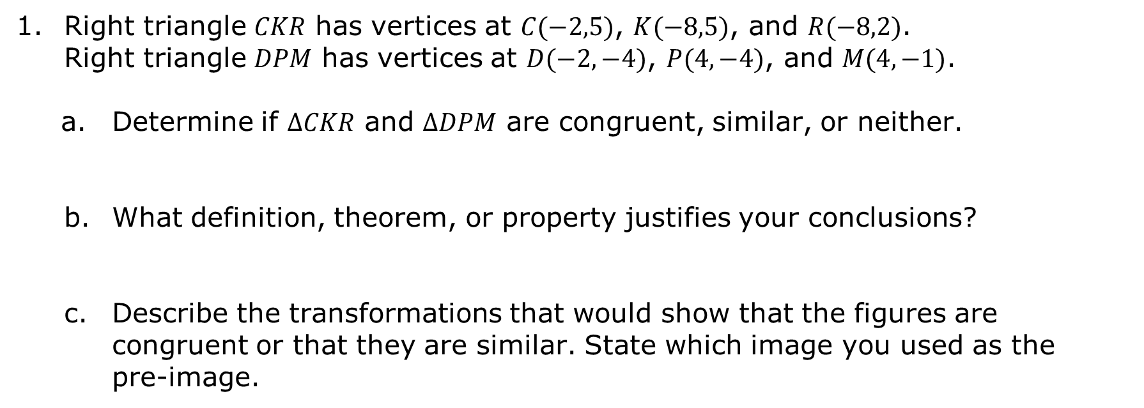
13.12.3 Guided Practice: Congruence and Similarity
Right triangle 𝐶𝐾𝑅 has vertices at $C(−2,5)$, $K(−8,5)$, and $R(−8,2)$. Right triangle 𝐷𝑃𝑀 has vertices at $D(−2,−4)$, $P(4,−4)$, and $M(4,−1)$.
Determine if $∆CKR$ and $∆DPM$ are congruent, similar, or neither.
What definition, theorem, or property justifies your conclusions?
Describe the transformations that would show that the figures are congruent or that they are similar. State which image you used as the pre-image.
volume 2, pg. 351

Slide 19
Ask a classmate for their description. Record their description and write your summary of their description. You are the only person who should write in the first two columns of the table. Have the person initial next to your summary stating that your summary was correct.
Description | My Summary of Their Description | Initials
volume 2, pg. 352

Slide 20
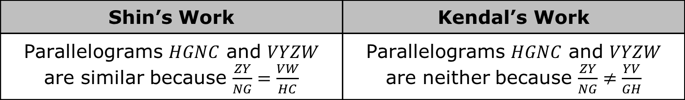
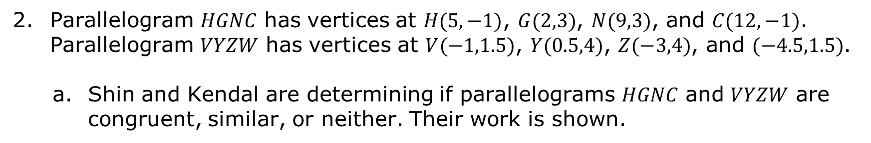
Parallelogram 𝐻𝐺𝑁𝐶 has vertices at $H(5,−1)$, $G(2,3)$, $N(9,3)$, and $C(12,−1)$. Parallelogram 𝑉𝑌𝑍𝑊 has vertices at $V(−1,1.5)$, $Y(0.5,4)$, $Z(−3,4)$, and $(−4.5,1.5)$.
Shin and Kendal are determining if parallelograms 𝐻𝐺𝑁𝐶 and 𝑉𝑌𝑍𝑊 are congruent, similar, or neither. Their work is shown.
Shin’s Work | Kendal’s Work
Parallelograms $HGNC$ and $VYZW$ are similar because $\frac{ZY}{NG}=\frac{VW}{HC}$ | Parallelograms $HGNC$ and $VYZW$ are neither because $\frac{ZY}{NG}≠\frac{YV}{GH}$
volume 2, pg. 352

Slide 21
Whose work do you agree with?
Write a note to the person who is incorrect explaining their mistake.
Means
I
Start
To
Acquire
Knowledge
Experience
Skills
volume 2, pg. 352

Slide 22

Your Turn
volume 2, pg. 353

Slide 23
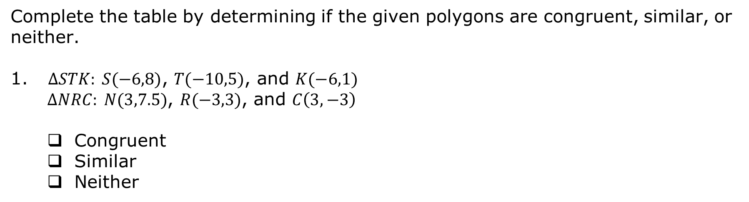
13.12.4 Your Turn!
Complete the table by determining if the given polygons are congruent, similar, or neither.
$∆STK: S(−6,8)$, $T(−10,5)$, and $K(−6,1)$
$∆NRC: N(3,7.5)$, $R(−3,3)$, and $C\left(3,−3\right)$
Congruent
Similar
Neither
volume 2, pg. 353

Slide 24
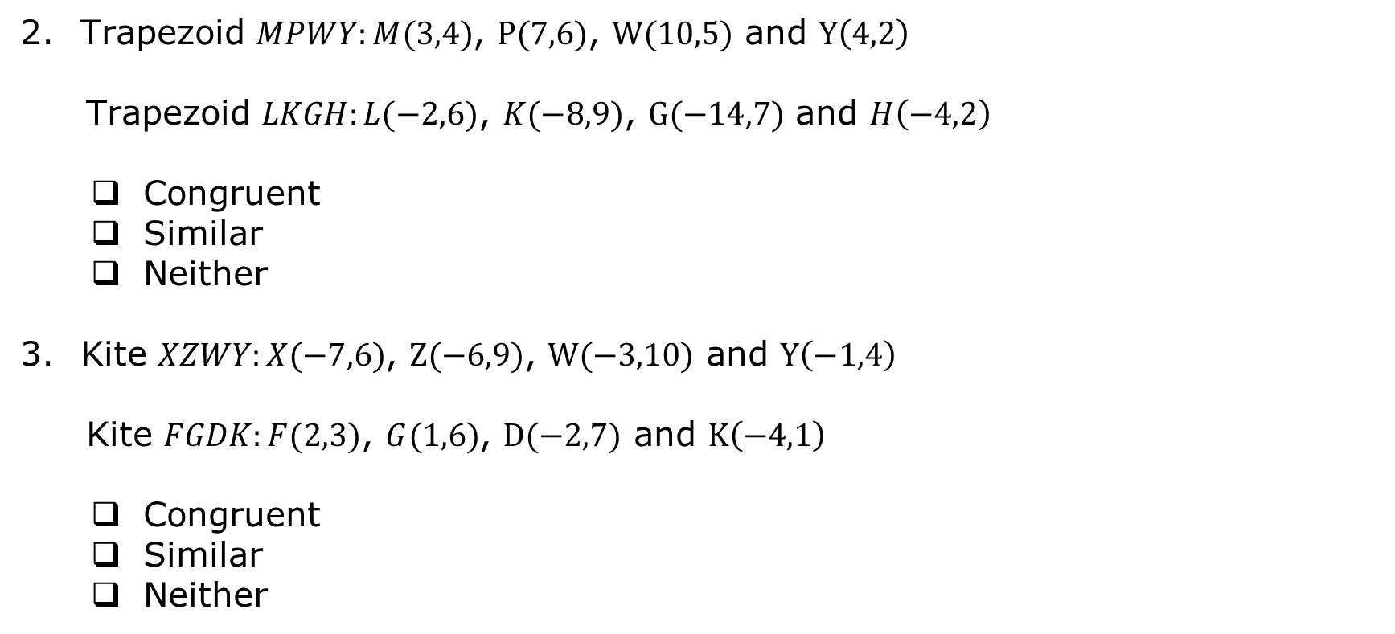
Trapezoid $MPWY:M(3,4)$, $P(7,6)$, $W(10,5)$ and $Y\left(4,2\right)$
Trapezoid $LKGH:L(−2,6)$, $K(−8,9)$, $G(−14,7)$ and $H\left(−4,2\right)$
Congruent
Similar
Neither
Kite $XZWY:X(−7,6)$, $Z(−6,9)$, $W(−3,10)$ and $Y\left(−1,4\right)$
Kite $FGDK:F(2,3)$, $G(1,6)$, $D(−2,7)$ and $K\left(−4,1\right)$
Congruent
Similar
Neither
volume 2, pg. 353

Slide 25

Wrap-Up
volume 2, pg. 354

Slide 26
13.12.5 Wrap-Up: Cool Down
Your friend is absent today and will need the notes from class. Write a quick note to teach them how to use coordinate geometry to justify congruence and similarity in polygons.
volume 2, pg. 354

